Slide 1
Links between quality of work
and performance
Radosław Owczarzak
Research Manager
Employment and Competitiveness Unit
1
Notes:
1

Slide 2
Policy context
Searching for new sources of growth through sustainable organisational performance at European workplaces – Lisbon, EU2020 targets
Promoting improvement of working conditions/quality of work through providing the evidence of their positive impact on employee and establishment performance (win-win strategies)
2

Slide 3
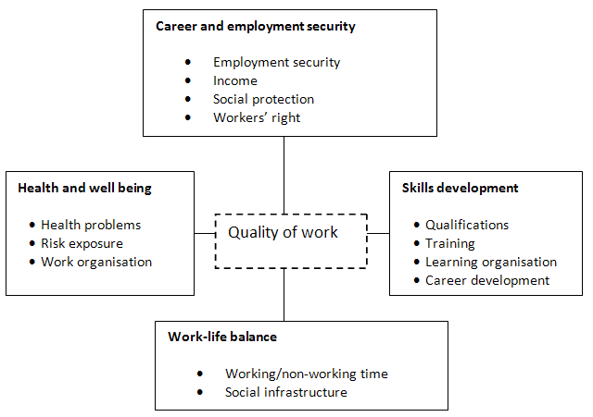
Sources: Eurofound (2002):“Quality of work and employment in Europe – Issues and challenges” and Eurofound (2007) Quality of work and employment in Europe
Quality of work and employment

Slide 4
Project objectives
Are job quality and company performance
opposite targets?
Literature review of academic research in the field since 1990 about:
HRM/workplace practices and human resource outcomes (employee turnover, motivation, satisfaction)
HRM/workplace practices and establishment outcomes (labour productivity, financial results, scrap rates etc.)
In-depth case studies 2010
Analysis of the new ECS2009 dataset
4

Slide 5
Previous research
Research on job quality has shown...
that workers are more satisfied and motivated when they...
Have a say in their workplace
Can organize work autonomously
Can work in a flexible manner
Get higher wages if they work harder
Can develop themselves, i.e. increase their skills
Have a secure job and a career perspective
28/09/2011
5

Slide 6
Long term time savings accounts remain an exception

Slide 7
Team work in Europe
Team work in Europe

Slide 8
Theoretical foundations
Ability, Motivation and Opportunities model (organisational psychology theory) - Linking HPWP and organisational performance
Ability: employees are equipped with the skills needed to undertake their jobs and discretionary effort (recruitment, selection and training)
Motivation: to use discretionary effort (extrinsic/financial, intrinsic and mutual trust/employees as stakeholders)
Opportunity: to involvement in the decision making process of the firm (autonomy, voice)
Notes:
8

Slide 9
Theoretical framework
Workplace practices
Training
Need for training checked
Proportion in high skilled jobs
Time off for training
Training for new tasks
Performance pay
Profit-sharing (and coverage)
Individual performance pay (for employees and coverage)
Share ownership (and access to all employees)
Team working
Importance of team working
Autonomy within team working
Working time
Flexible working (and level of take-up)
Part-time working (and level of take-up)
Managers/ professionals working part time
Social dialogue practices
Presence of formal employee representation
Ad hoc consultation
Consultation over pay*
Employee outcomes
(Low) motivation
Employee complaints*
Sickness absence
Staff retention
Joint efforts to solve problems*
Hostile relationship between representatives*
Organisational outcomes
Productivity
Change in productivity over time
Work climate
Economic state of organisation
Industrial action*
Organisational context
Size
Sector
Ownership
Expansion/contraction
Major change (eg relocation)
Country of location
Notes:
9

Slide 10
Links between workplace practices and EMPLOYEE outcomes (1)
 | Problem with absenteeism | Problem with employee motivation | Problem with staff retention
Need for training checked periodically | -0.12 | -0.29 | 0.00
Proportion of high-skilled workforce >40% | -0.77 | -0.35 | 0.04
Time off for training given | -0.02 | -0.07 | 0.03
Training for new tasks | -0.04 | -0.08 | 0.06
Any Profit sharing offered | -0.17 | -0.10 | -0.01
Profit sharing offered to all | -0.16 | -0.06 | -0.04
Any performance pay outside top management | 0.10 | 0.15 | 0.27
Individual performance pay for 25% + | -0.02 | 0.05 | 0.20
Any share ownership offered | -0.16 | -0.01 | -0.02
Share ownership offered to all | -0.10 | -0.08 | -0.10
green: improving outcome, significant 95% red: reducing outcome, significant 95%
Notes:
10

Slide 11
Links between workplace practices and EMPLOYEE outcomes (2)
 | Problem with absenteeism | Problem with employee motivation | Problem with staff retention
Team working important characteristic | -0.02 | -0.13 | 0.14
Team decides autonomously | -0.14 | -0.27 | -0.15
Flexible working possible | -0.10 | -0.01 | 0.14
Flexible working time more than 20% | -0.38 | -0.12 | 0.06
Part-time work more than 20% | 0.18 | 0.15 | 0.27
Management and highly skilled staff working part-time | 0.02 | 0.13 | 0.18
Employee representation in place | 0.22 | 0.11 | -0.13
Ad hoc consultation in absence of employee representation | -0.01 | 0.00 | 0.12
green: improving outcome, significant 95% red: reducing outcome, significant 95%
Notes:
11

Slide 12
Links between workplace practices and ORGANISATIONAL outcomes (1)
 | Higher than average productivity | Increased productivity over last three years | Good work climate | Economic situation of firm good
Need for training checked periodically | 0.44 | 0.46 | 0.29 | 0.34
Proportion of high-skilled workforce > 40% | 0.28 | 0.18 | 0.22 | 0.13
Time off for training given | 0.23 | 0.33 | 0.09 | 0.11
Training for new tasks | 0.24 | 0.36 | 0.10 | 0.12
Any Profit sharing offered | 0.33 | 0.15 | 0.05 | 0.18
Profit sharing offered to all | 0.31 | 0.09 | 0.09 | 0.15
Any performance pay outside top management | 0.32 | 0.37 | -0.03 | 0.17
Individual performance pay for 25% + | 0.28 | 0.26 | 0.06 | 0.23
Any share ownership offered | 0.19 | 0.01 | 0.04 | 0.18
Share ownership offered to all | 0.20 | 0.06 | 0.11 | 0.28
green: improving outcome, significant 95% red: reducing outcome, significant 95%
Notes:
12

Slide 13
Links between workplace practices and ORGANISATIONAL outcomes (2)
 | Higher than average productivity | Increased productivity over last three years | Good work climate | Economic situation of firm good
Team working important characteristic | 0.45 | 0.44 | 0.20 | 0.12
Team decides autonomously | 0.26 | 0.24 | 0.17 | 0.10
Flexible working possible | 0.15 | 0.14 | 0.00 | 0.00
Flexible working time more than 20% | 0.19 | 0.10 | 0.04 | 0.02
Part-time work more than 20% | 0.01 | -0.09 | -0.06 | 0.02
Management and highly skilled staff working part-time | -0.11 | 0.00 | -0.14 | -0.14
Employee representation in place | -0.06 | 0.10 | -0.23 | -0.16
Ad hoc consultation in absence of employee representation | 0.19 | 0.12 | 0.26 | 0.16
green: improving outcome, significant 95% red: reducing outcome, significant 95%
Notes:
13

Slide 14
Relationship between employee outcomes and organisational outcomes
 | Higher than average productivity | Increased productivity over last three years | Good work climate | Economic situation of firm good | Industrial action over the last year
Employee outcome low motivation | -0.52 | -0.38 | -1.32 | -0.71 | 0.30
Employee outcome high absenteeism | -0.36 | -0.25 | -0.61 | -0.37 | 0.27
Employee outcome retention problem | -0.22 | -0.15 | -0.68 | -0.45 | -0.13
red: reducing outcome, significant 95%

Slide 15
In-depth case studies
6 countries (Austria, Czech Republic, France, Germany, Spain and Sweden)
4 sectors (Electro-mechanical engineering, Financial service, Food, Wholesale and Retail)
22 case studies – conducted: May, June, July 2010
Notes:
15

Slide 16
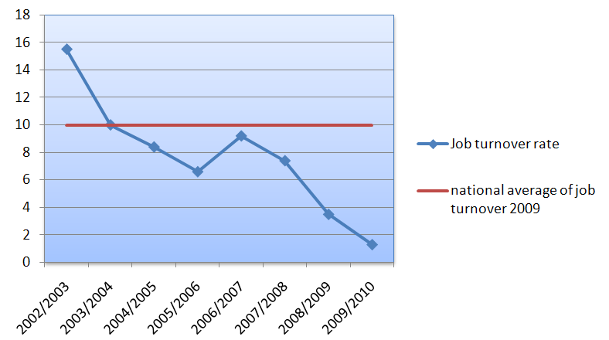
Change in staff turnover at Osram 2002-2010
Notes:
16

Slide 17
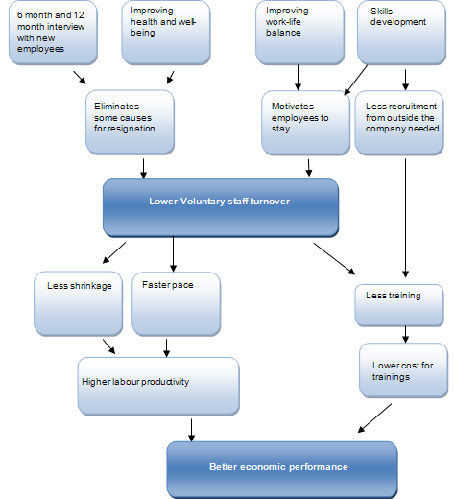
Lowering voluntary staff turnover at Osram
Notes:
17

Slide 18
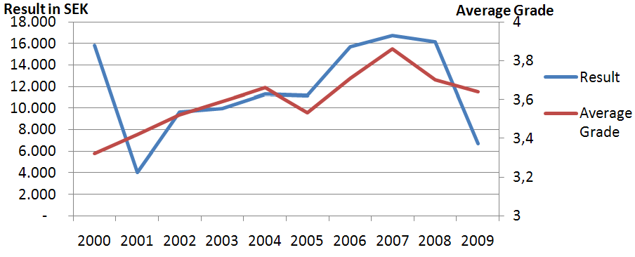
Quality of work and net result Colly Components
Notes:
18

Slide 19
Analytical framework (cont)
Measure to improve Quality of Work
Result
Effect on HR outcome
Intermediary effect
Indirect impact on performance
Direct impact on economic performance

Slide 20
Company | Type of measure | Result | Effect on HR outcome | Intermediary effect | Indirect impact on performance | Direct impact on economic performance
Ceska Sporitelna (CZ) | Skills Health Work-life balance | More knowledge sharing More satisfied employees Psychological contract | Less stress Less sick absence Less voluntary staff turnover | Less cost of sickness Reduced cost for training new employees More efficient work | Higher Productivity Increased sales No staff Reduction during crisis | Higher return on equity
Wüstenrot (AT) | Health Flexible working hours Job security | Worker involvement Better workplace atmosphere Higher job-satisfaction Loyalty and sense of belonging | Engaged workforce | Higher quality of work |  | Increased economic performance

Slide 21
Company | Type of measure | Result | Effect on HR outcome | Intermediary effect | Indirect impact on performance | Direct impact on economic performance
Garabi (ES) | Work Organization | Worker Involvement Mutual trust Job satisfaction | Reduced Stress Low sick absence |  | Increased sales Higher Productivity | Higher profitability
Colly Components (SE) | Reorganization of work Work-life balance Health Skills | Job satisfaction Pride | Reduced stress Low sick absence Low voluntary staff turnover | Less costs to train new employees | Less hit by economic crisis than competitors | Increased net result High profitability

Slide 22
Observations (1)
Companies “bundle” initiatives to improve quality of work – difficulties in monitoring and measurement of the impact on performance
Companies are generally not aware of all links between quality of work and performance
Sectors seem to count: Finance and Food are more conscious then Electro-mechanical engineering, Wholesale and Retail sectors
Countries seem to count: e.g. psychological contract in Czech Republic
Performance in turbulent times often equals no layoffs
Notes:
22

Slide 23
Observations (2)
Most obvious links are found with respect to training, skills and employability
Improved quality of work is linked to better performance . . . most people interviewed believed
Little hard evidence is found (lack of evaluations, diverse workplace practices and performance indicators)
Notes:
23

Slide 24
Conclusions
Manage staff expectations about careers and consider how to develop internal labour markets
Integrate pay and training practices and manage staff expectations about rewards for learning new skills
Provide equality of opportunities to staff using different modes and forms of working time
Need for scientific base-line studies in longitudinal basis (WP2013-2016?)
Promoting awareness ( and IMPLEMENTATION) of the links between quality of work and performance
Moving social dialogue to the next level where common goals will include increasing quality of work
Notes:
24

Slide 25
Thank you very much!
ROW@eurofound.europa.eu

Slide 26
Innovative practices and performance
28/09/2011
26

